Slide 1
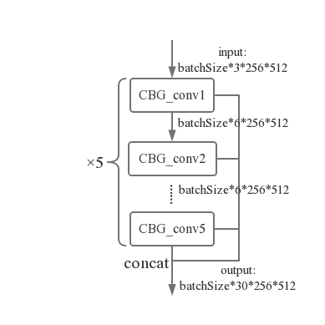
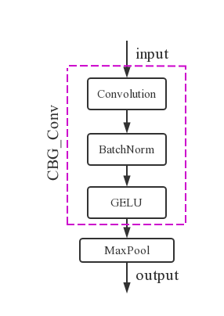
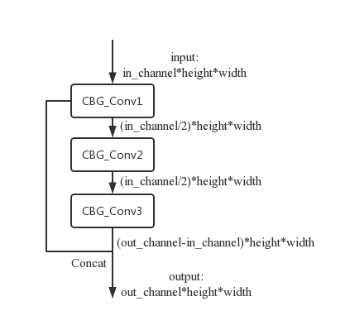
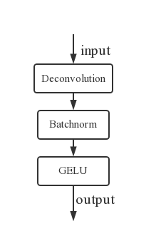
input: batchsize*3*256*512
output: batchsize*2*256*512
32*256*512
8*256*512
30*256*512
8*256*512
32*128*256
attention
64*64*128
128*32*64
256*16*32
256*16*32
128*32*64
16*256*512
256*32*64
64*64*128
128*64*128
32*128*256
64*128*256
ScopeConv
attention
kernelSize:3×3
other:5×5
CBG_Conv
CBG_Conv+Pooling
DBG_Conv
Res_Conv

Slide 2
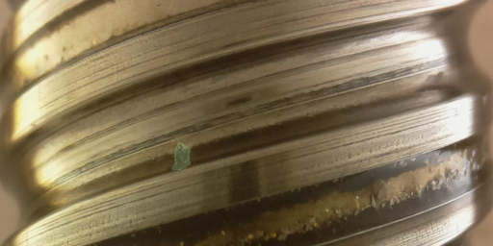

Slide 3
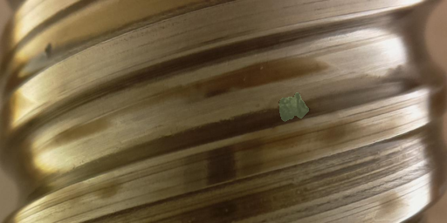

Slide 4
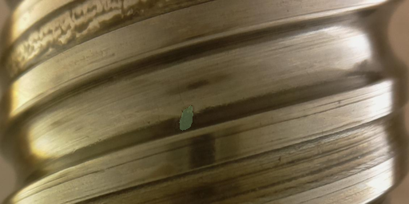

Slide 5
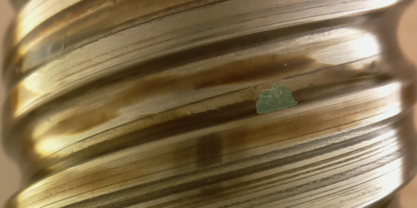

Slide 6
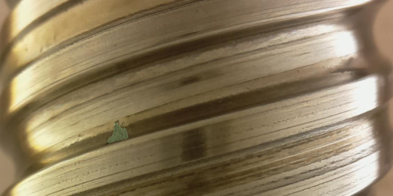

Slide 7
